Slide 1
Memristor-based Deep Spiking Neural Network with a Computing-In-Memory Architecture
A demonstration of spatiotemporal information processing capability of the proposed designed architecture

Slide 2
Index
What are SNN?
Working of SNNs
Encoding Scheme
LIF Neuron Model
LIF vs Perceptron
ANNs vs SNNs
Applications of SNN

Slide 3
What are Spiking Neural Networks (SNN)
Spiking neural networks (SNNs) are a type of neural network that more closely mimic how biological neurons operate in the brain. Spiking neural networks offer a more biologically realistic approach by incorporating the dimension of time through spikes, which can lead to advantages in energy efficiency and the processing of temporal information. In the following slides to come we explain the working behind spiking neural networks, the different available models of neurons involved in SNNs, how data is encoded/decoded using SNN and its benefits over traditional ANN.

Slide 4
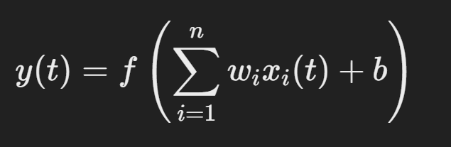
Working of Spiking Neural Networks (SNNs)
As stated earlier, SNNs are based on realistic models and activity patterns of the biological brain/neurons because of their spiking nature. Due to this spiking nature of SNNs it makes them vastly different from artificial neural networks (ANNs) as the later is continuous in nature.
In the case of ANNs:
Each neuron computes a continuous activation function (like sigmoid) based on weighted inputs.
Neuron output is a scalar value representing the neuron's activity.
The mathematical expression denoting the output state of a neuron is given by :

Slide 5
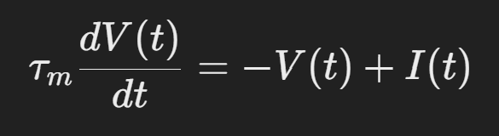
Working of SNNs (cont.)
However, unlike the working of ANNs, SNNs differ from them in the following ways :
Neurons in SNNs generate discrete action potentials (spikes) whenever their internal membrane potential crosses a threshold.
Neuron state is represented by a differential equation.
Unlike ANNs, the output of neuron in an SNN is not a continuous value. At each point in time there is a check of any input spikes, these spikes can raise the membrane voltage of the neuron, and once the voltage has crossed a particular threshold value, an output spike is generated, which gives us the output or propagates to other neurons as the case may be. The mathematical expression denoting the membrane voltage of an SNN neuron is given by :

Slide 6
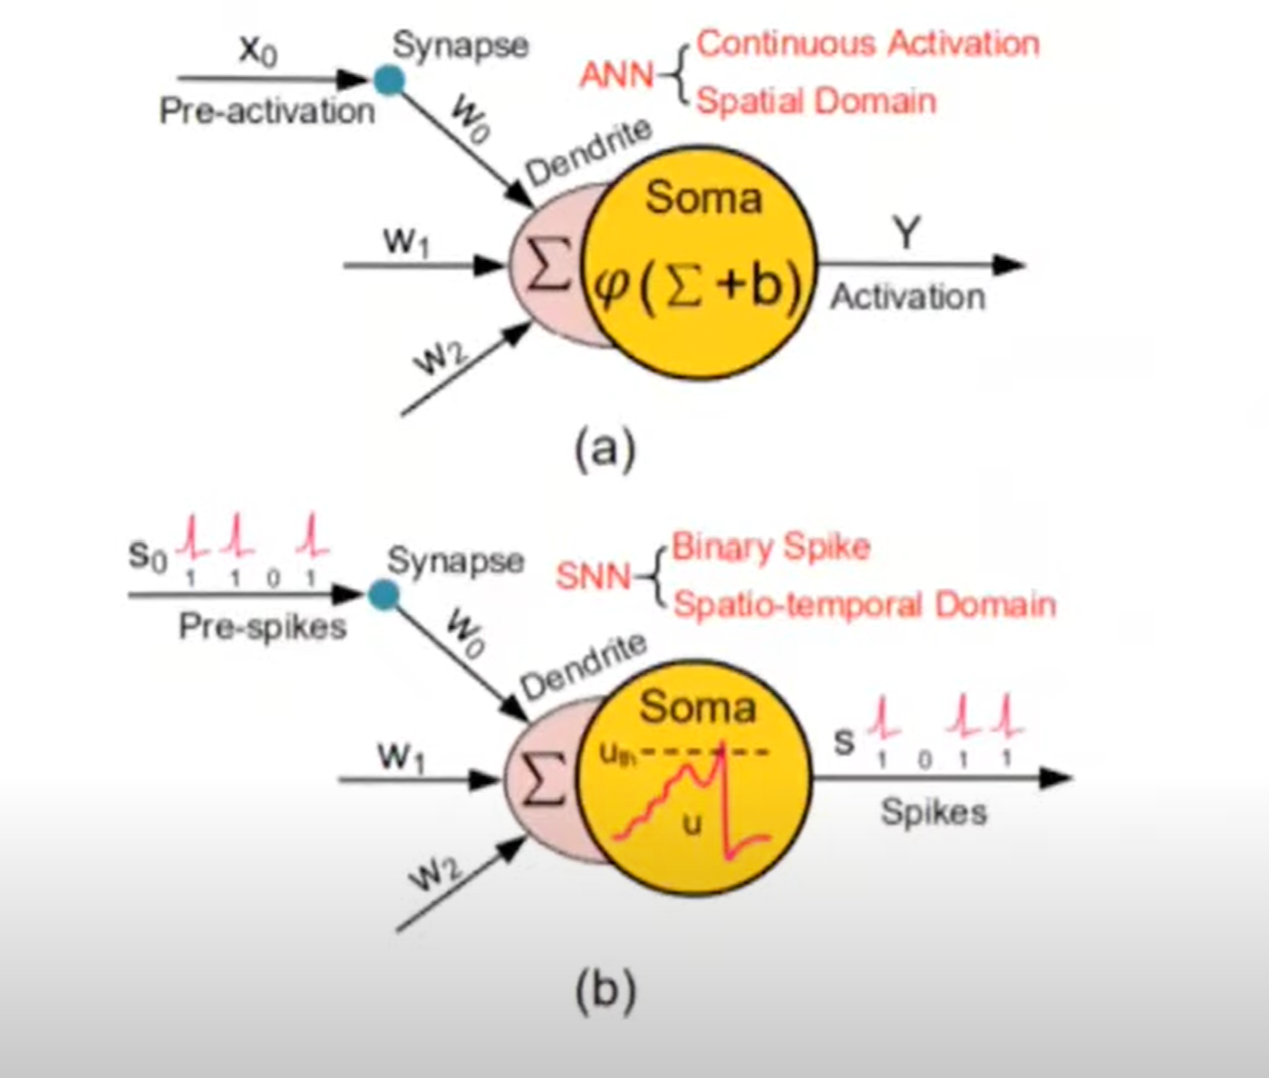
Diagrammatically Distinguishing between ANN and SNN

Slide 7
Input/Output Spike Encoding Schema
We previously saw that inputs to SNNs are spikes. Essentially, the information must be converted into a spike train before it is introduced into the SNN architecture. Therefore there has to be an encoding scheme which convert data/excitation events into spike trains/sequences.
Encoding schemes are usually of 2 types :
Rate Encoding : Where data is encoded into the timing of the spike inputs.
Temporal Encoding : Where data is encoded into the exact timings of the spike inputs.

Slide 8
Temporal Encoding (cont.)
This type of coding technique involves encoding data on the basis of the exact timestamps at which input spikes arrive at the neuron and/or the time interval between them. 2 popularly used temporal encoding schemes are :
TTFS : Stands for “Time To First Spike”. Encoding where information is represented by the timing of a neuron's first spike. It relies on the latency—how quickly a neuron fires after receiving an input. In this scheme, a stronger stimulus typically results in an earlier spike, while a weaker stimulus leads to a later spike.
ISI : Stands for “Inter-Spike Interval”. Encoding where information is carried in the time differences between consecutive spikes rather than in the precise timing of a single spike. In this case, the pattern of inter-spike intervals (ISIs) conveys features of the input stimulus. Unlike the case in TTFS, here a neuron may fire repeatedly in response to a sustained input.

Slide 9
Temporal Encoding (cont.)
Amongst the two spike encoding schemes, i.e, rate and temporal encoding, temporal encoding is preferred over rate encoding as it is more energy efficient compared to rate encoding because of the fewer spike events it generates.
Furthermore amongst the two temporal encoding schemes, ISI is preferred over TTFS since it carries information in both the timing of the spikes as well as the distance between the spikes based on the intensity of the information. Thus the information that can be conveyed by ISI encoding is effectively more than the information that can be conveyed by the same amount of TTFS encoded spikes.

Slide 10
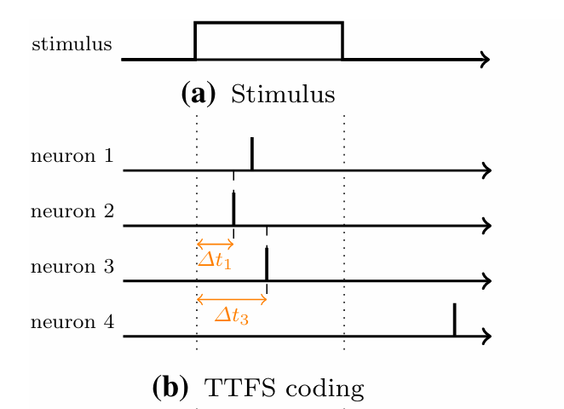
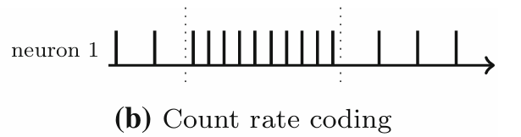
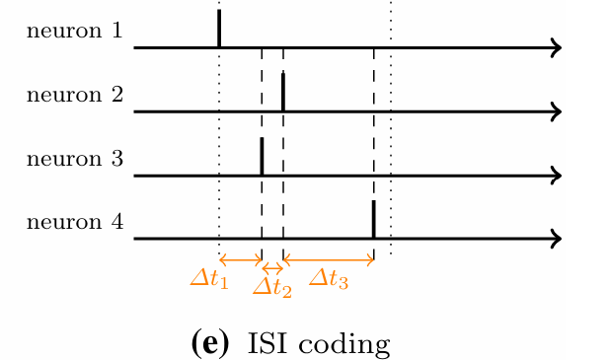
TTFS vs ISI vs Count Rate Encoding

Slide 11
Leaky Integrate-and-Fire (LIF) Neuron
The backbone of any form of neural network, be is spiked or artificial, is the model of the neuron making up the network. Spiking neural networks (SNNs) employ various neuron models that balance biological realism with computational efficiency. A few commonly used models are:
Leaky Integrate-and-Fire (LIF) Model : A simple yet popular model neuron model used widely in almost every application of SNN.
Hodgkin-Huxley Model : A detailed and biologically accurate model that describes the ionic mechanisms behind action potentials using a system of differential equations. While highly realistic, it is computationally intensive.
Izhikevich Model : Designed to capture a wide range of spiking and bursting behaviors observed in biological neurons, it strikes a balance between computational efficiency and biological realism.

Slide 12
Leaky Integrate-and-Fire (LIF) Neuron (cont.)
At the heart of ISI coding is the LIF neuron model. It is a simple yet popular model where the neuron integrates incoming currents with a leakage term. When the membrane potential reaches a set threshold, a spike is fired and the potential is reset(depending on the type of spiral neural models used).
The core concepts involved behind LIF neuron model are as follows :
Integration of Inputs : The neuron sums or "integrates" incoming electrical currents (synaptic inputs), which causes its membrane potential to rise over time.
Leakage : The membrane potential doesn't just keep rising indefinitely. Instead, it decays or "leaks" back towards a resting value. This mimics the natural tendency of neurons to lose charge over time if no additional input is received.

Slide 13
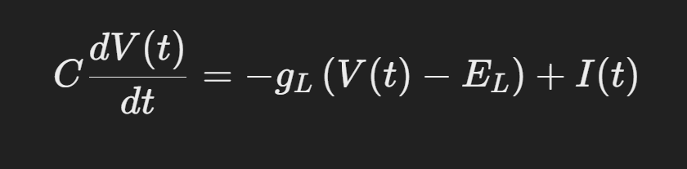
LIF Neuron model (cont.)
The LIF neuron model is typically mathematically defined by the following :
While the perceptron neurons provide a straightforward, static mapping from inputs to outputs, the LIF neuron model captures the temporal evolution of neuronal activity, including how inputs accumulate over time, leak away, and ultimately trigger spikes when a threshold is reached.
This fundamental difference is what allows SNNs to process temporal information in a way that static models cannot.

Slide 14
Differences between Perceptron and LIF Neuron Models
Feature | Perceptron | LIF Neuron
Time Dynamics | Evaluates inputs in a single, instantaneous computation. | Integrates inputs over time, with dynamics dictated by a differential equation
Output Representation | Produces a single binary output based solely on the current weighted sum. | Produces a spike (or a train of spikes) over time, capturing temporal aspects of the input.
Complexity | Lower complexity due to straightforward weighted summation and thresholding | Higher complexity as it involves solving differential equations to model membrane potential dynamics

Slide 15
Major Differences between ANNs and SNNs
Serial Number | Features | ANNs | SNNs
1 | Information Encoding | Continuous values | Discrete Spikes (events)
2 | Time Representation | Static or discrete time | Continuous Time
3 | Power Consumption | Higher | Lower
4 | Complexity | Simpler | Biologically more realistic
5 | Mathematical Basis | Algebraic Equations | Differential Equations

Slide 16
Why pick SNN over Artificial Neural Networks (ANN)?
01
Temporal Dynamics : SNNs communicate through discrete electrical pulses called spikes. The timing of these spikes is crucial, meaning that when a spike occurs carries information in addition to how often spikes occur.
02
Biological Plausibility : By modeling neurons more realistically—integrating incoming spikes over time and firing only when a threshold is reached—SNNs capture aspects of neural behavior seen in real brains.
03
Energy Efficiency : Because they are event-driven (neurons only process information when a spike occurs), they have the potential to be more energy efficient.

Slide 17
Applications of SNN in Computing-in-memory Architecture

Slide 18
Application objective
To overcome the problem of the Von-Neumann architecture bottleneck by switching to in-memory computing architectures for heavy and data intensive operations/processes. Furthermore, integrate the architecture with a deep scaleable SNN, to make the architecture less susceptible to large values of latency and to make it more energy efficient.

Slide 19
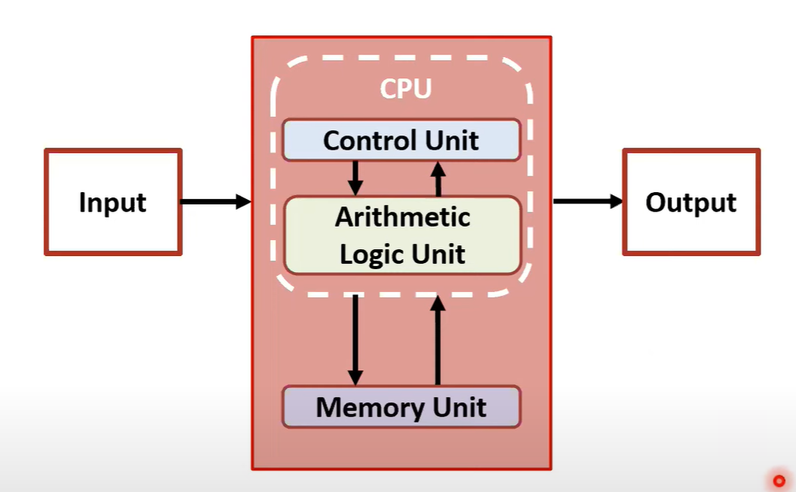
Von Neumann Architecture
The Von Neumann Architecture is a foundational computer design model that organizes a computer into distinct components with specific roles.
However due to physical limitations of CMOS technology and storage capacity, a large amount of energy is spent is on data processing. Physical movement of data to-and-from the memory unit consumes a large amount of energy and time, and this is known as “Von Neumann Bottleneck”
Von Neumann Architecture

Slide 20
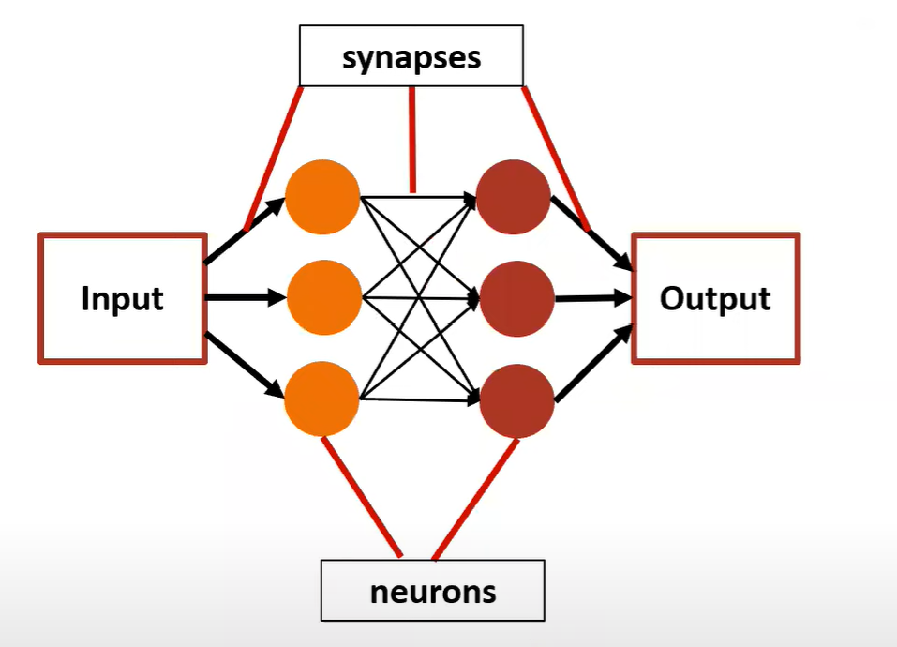
Neuromorphic Systems
Neuromorphic architectures are inspired by the structure and functioning of biological neural systems.
Unlike Von Neumann systems, neuromorphic designs combine memory and processing elements. Von Neumann systems focus on sequential processing and centralized memory, while neuromorphic architectures emphasize distributed, parallel, and energy-efficient computing, drawing inspiration from the human brain.
Neuromorphic Systems

Slide 21
Von Neumann vs Neuromorphic System
Aspect | Von Neumann | Neuromorphic
Organization | Separate processing (CPU) and memory units | Integrated memory and processing. Computations are performed where data is stored
Processing | Primarily sequential execution | Massively parallel and event-driven
Data Transfer | Data and instructions are moved back and forth | Minimal data movement since memory and processing are co-located
Energy Efficiency | Generally less energy efficient | High energy efficiency

Slide 22
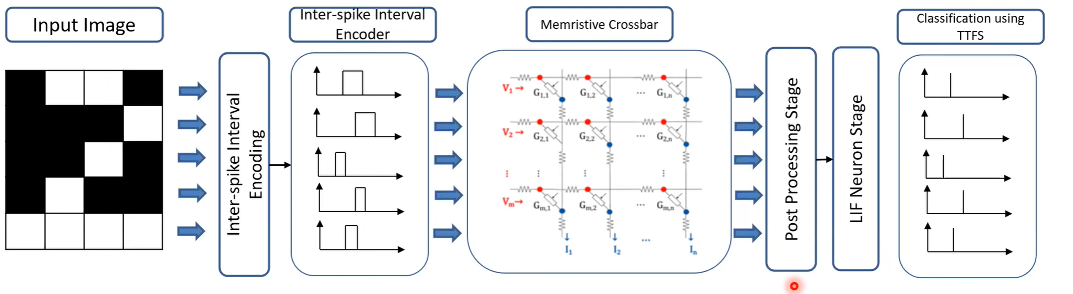
Proposed Computer-In-Memory Deep SNN Embedded Architecture

Slide 23
Execution Flow of Proposed Architecture
04
Output Classification
Input Data Encoding
First step involves encoding the input data using ISI temporal encoding.
LIF neurons generate output spikes following TTFS encoding scheme making it energy efficient
01
03
Fast Vector Matrix Multiplication
Post Processing
Output currents of memristor crossbars is fed as input to LIF neurons in the next stage.
Memristor crossbars are used for this purpose.
02

Slide 24
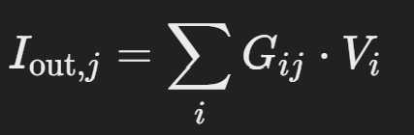
Memristor Crossbars
A memristive crossbar is a hardware architecture that arranges memristors in a grid-like structure—typically at the intersections of perpendicular sets of conductive lines.
In a memristive crossbar, each intersection point contains a memristor, a two-terminal device whose resistance (or conductance) can be modulated and retained even without power. This array structure allows for a very high density of elements in a compact area. The crossbar facilitates analog computations like vector–matrix multiplications. By applying input voltages along the word-lines and reading the currents at the bit-lines, the output current on each bit-line is the sum of the products of the input voltages and the memristor conductances at each intersection. The output current at the intersection of the i(th) row and j(th) column is given by :

Slide 25
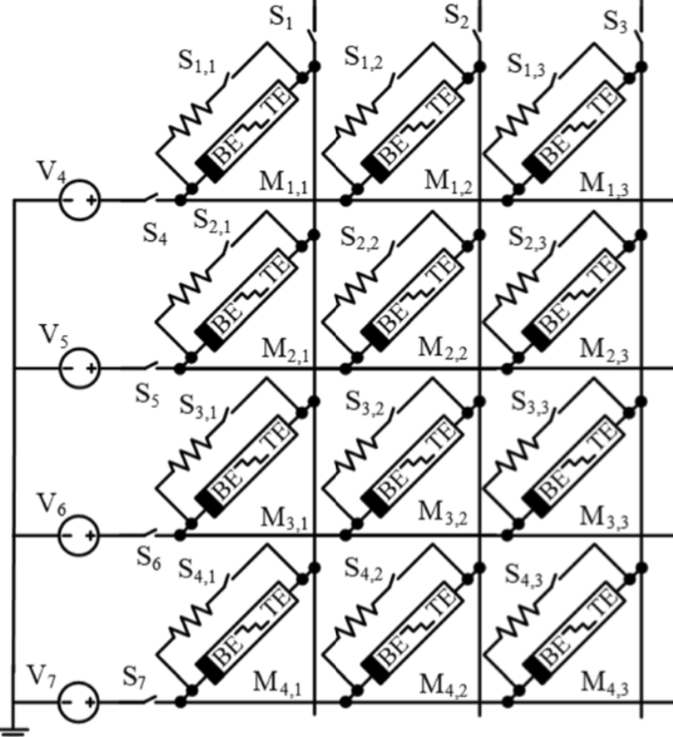
Memristor Crossbars (cont.)

Slide 26
Proposed Enhanced SNN Architecture

Slide 27
Adaptive Threshold Mechanism
Extends paper’s CIM SNN architecture.
Novel tweak:
→ Adaptive threshold modulation for ISI encoding.
→ Dynamically adjusts neuron firing threshold to enhance noise robustness.
Goal: To improve accuracy on inputs with minimal power overhead

Slide 28
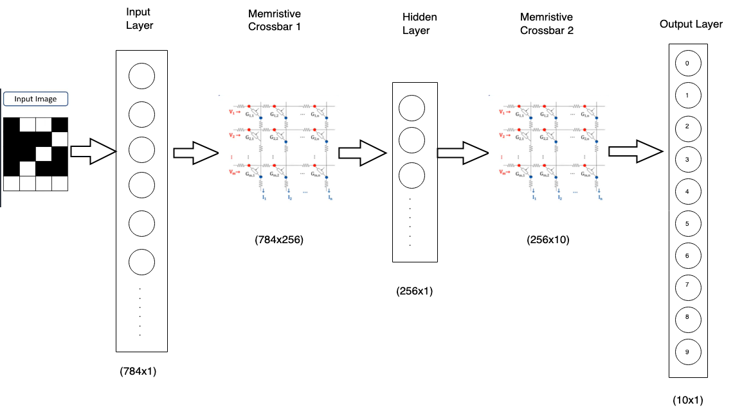
Architecture Design

Slide 29
Symbol | Meaning
V | Membrane Potential (mV)
I | Input Current (pA)
R | Membrane Resistance
𝛕 | Membrane Time Constant (ms)
V_{th} | Firing Threshold (mV)
V_{th, base} | Baseline Firing Threshold (mV)
I_{in} | Input Current to Neuron (pA)
k | Scaling factor for input depending threshold
δ_{th} | Threshold increment after a spike (mV)
𝛕_{th} | Threshold Decay Time Constant (ms)

Slide 30
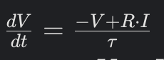
Standard LIF model(fixed threshold)
Equation:
Neuron fires when V > V_{th,base}, then resets V =0.
Parameters: V_{th,base} = 1.5mV(input layer), 0.5mV(hidden layer).

Slide 31
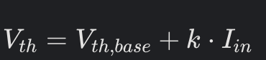
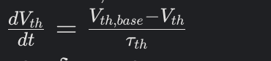
Adaptive Threshold
Input dependent threshold:
Dynamic threshold evolution:
After each spike: Vth​ increases by δth​, making subsequent spikes harder.
Parameters: δth=0.5 mV, τth​=30ms, k=0.1 mV/pA

Slide 32
Why Adaptive Threshold?
→ Reduces false spikes caused by noisy inputs (e.g., pixel intensity variations in MNIST).
→ Improves reliability of ISI encoding for temporal data processing.
→ Enhances sparsity in spiking activity, reducing computational load in memristor crossbars.
→ Increases adaptability to varying input intensities, improving generalization across datasets.
→ Mitigates overfitting to specific noise patterns, enhancing robustness in real-world applications.
Implementation:
→ Simulated using Brian2 with a 20 ms duration per sample.

Slide 33
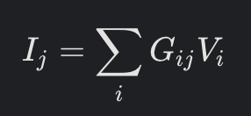
Memristor Crossbar Implementation
Function: Performs analog vector-matrix multiplication
→ G_{ij}: Memristor conductance (ranging from 1 µS to 1 mS)
→ V_{i} ​: Input voltages derived from spike counts
Crossbar details:
→ Crossbar 1: 784x256 (connects input layer to hidden layer)
→ Crossbar 2: 256x10 (connects hidden layer to output layer)
→ Weights: Normalized from a trained Spiking Neural Network (SNN) using snntorch

Slide 34
Simulation:
→ Implemented via NumPy matrix multiplication.
→ Approximates the CIM approach from the paper, achieving an energy efficiency 2.51pJ/synapse.
Advantages:
→ Eliminates the von Neumann bottleneck.
→ Provides energy-efficient and scalable processing.

Slide 35
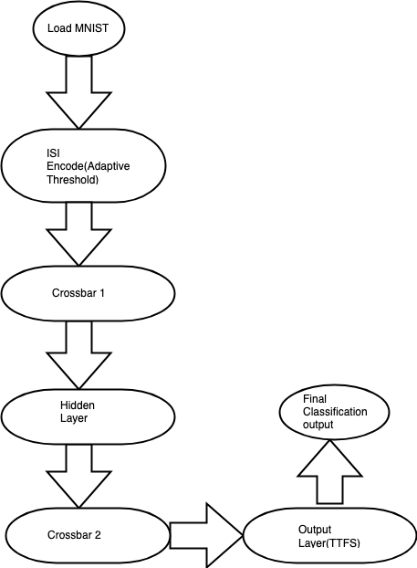
Complete Workflow

Slide 36
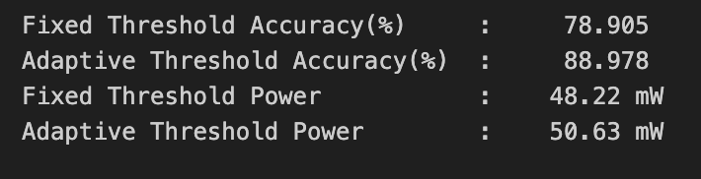
Results

Slide 37
Inference
Key findings:
→ Adaptive threshold enhances noise robustness in ISI-based SNNs.
→ Validates tweak’s potential for edge computing (e.g., IoT, robotics).
Advantages:
→ Energy-efficient CIM (2.51 pJ/synapse, per paper).
→ Scalable for larger datasets with hardware implementation.
Limitations:
→ Simplified ISI encoding reduces accuracy.
→ Software simulation omits analog memristor effects.

Slide 38
Future Work
Implement precise ISI encoding (vs. spike counts).
Simulate analog memristor effects (e.g., resistance variation).
Test on hardware CIM platforms for real-world performance.

Slide 39
Conclusion
Proposed adaptive threshold tweak improves SNN robustness.
Successfully implemented and tested on noisy MNIST (88.978% accuracy).
Paves the way for energy-efficient, noise-robust neuromorphic systems.

Slide 40
THANK YOU

